Slide 1


Signal and Source Separation
of Pop-Culture Music
using Classical Machine Learning Techniques
SIGNAL SOURCE SEPERATION
GROUP 20

Slide 2
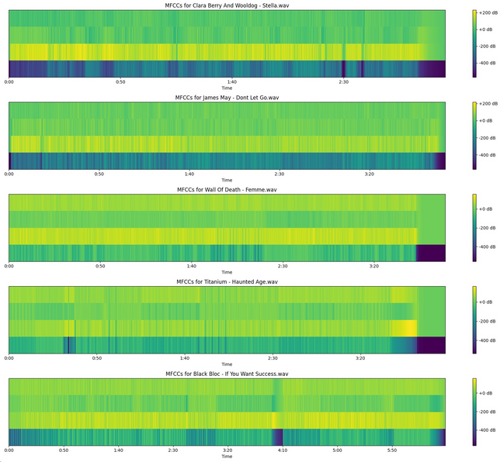
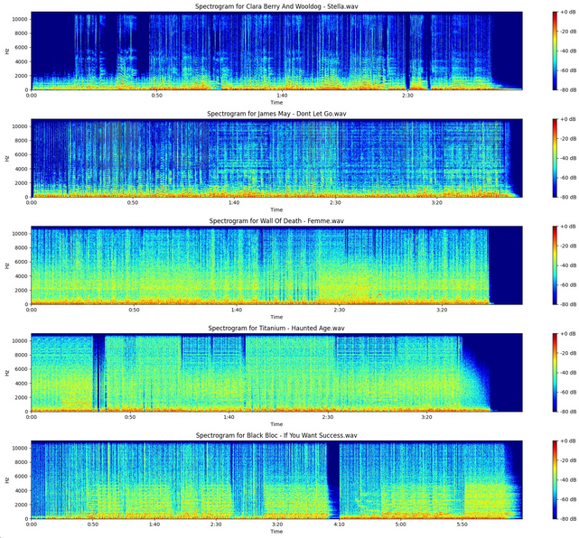
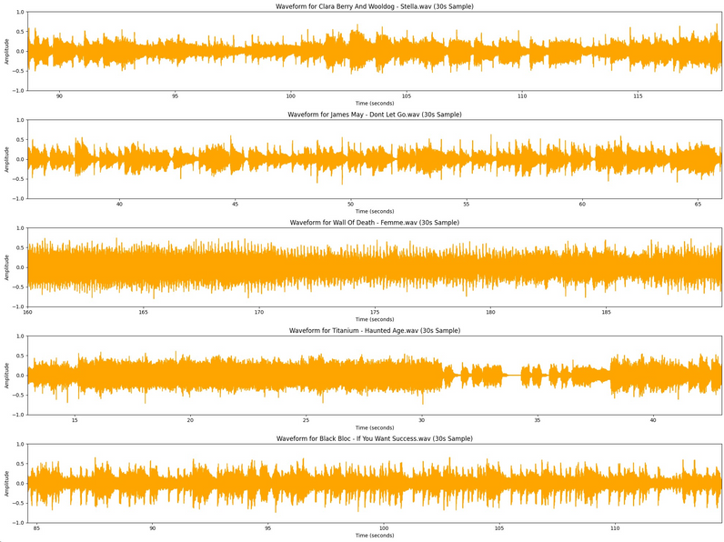
EXPLORATORY
DATA ANALYSIS
DOMAIN
RESEARCH
Waveform
STFT
Band Pass Filters
Signal Processing
Harmonics
Pitch
Modulations
Audio Modelling
MFCC
SPECTOGRAM
Expectation Maximisation
Priors
Gaussian Distribution
Probability Theory
WAVEFORM

Slide 3
Independent
Component Analysis
Expectation
Maximization
Principal Component Analysis
Sparse
Component Analysis
EXISTING
METHODS
ANALYSIS
Spatial
Techniques
Robust
PCA
Kernel Adaptive
Methods
Spectral
Subtraction

Slide 4
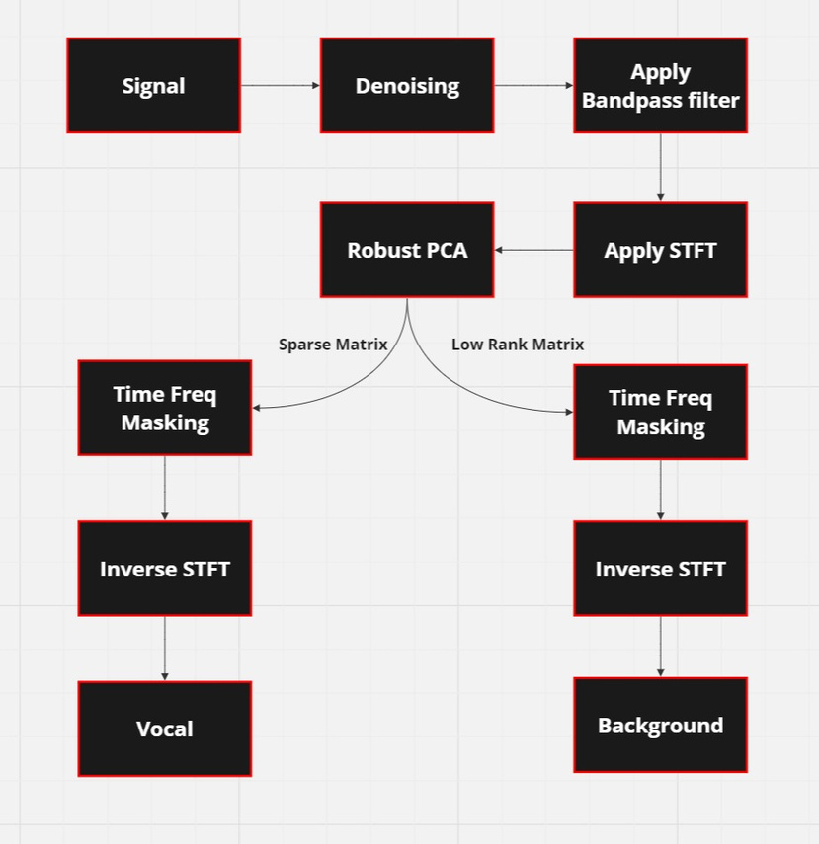
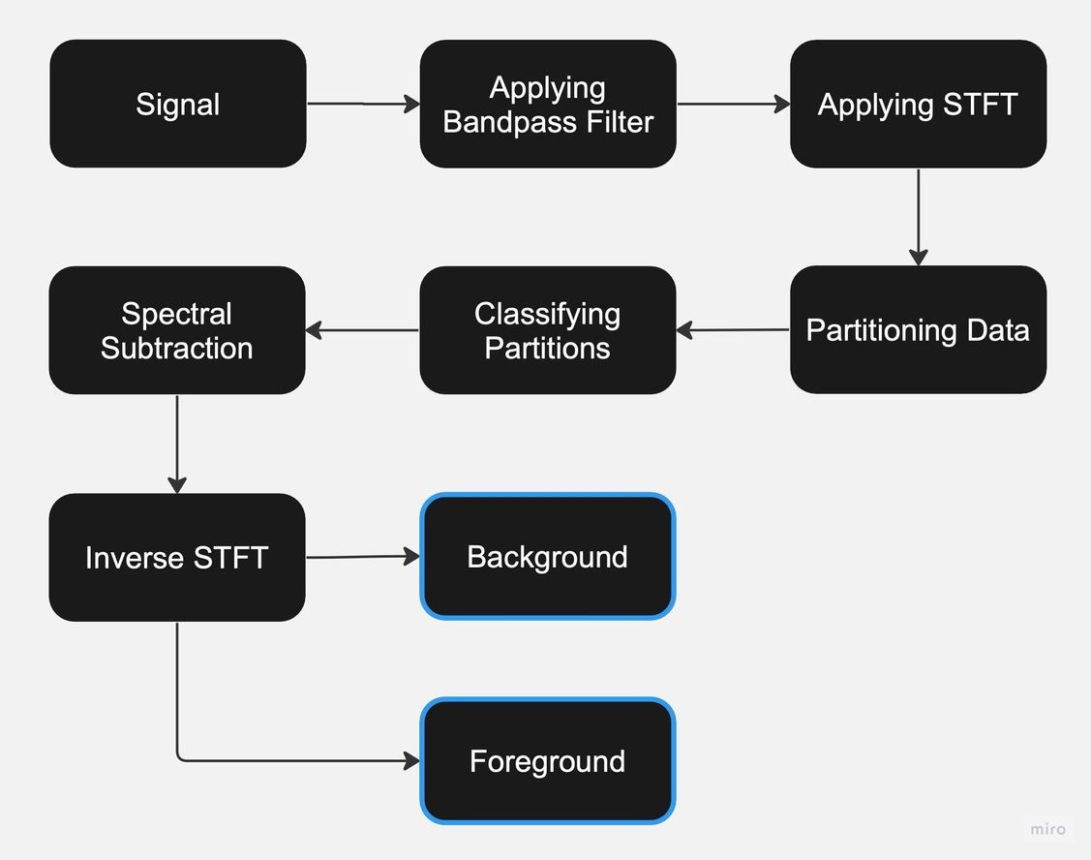
ATTEMPTED METHODS
Robust PCA Method
Spectral Subtraction using Classification

Slide 5
ATTEMPTED METHODS
Harmonic and Percussive Source Separation
IVA with Gaussian Prior
Signal
STFT
Signal
STFT
Initialise Mixing Matrix
Apply IVA
Harmonic and Percusive Mask
HPSS
Source Reconstruction
Apply Mask on Signal
Source Reconstruction (Inverse STFT)
Post Processing
Inverse STFT

Slide 6
ATTEMPTED METHODS
Non-Negative Matrix Factorization
Gaussian Mixture Models
GMMs are used for audio source separation, especially in speech signals.
Random audio sampling and feature extraction, focusing on MFCCs, spectral contrast, and chroma features.
Uses manually filtered 5-second audio sequences without vocals.
A GMM model is trained to learn what to subtract from the full sample.
The approach struggles with full sample queries using 5-second windows with 50% overlap.
NMF decomposes a signal's spectrogram into two non-negative matrices: basis (W) and activation (H).
The matrices represent spectral templates and their temporal activations.
Uses iterative optimization techniques like KL divergence and ADMM for refinement.
Isolates distinct signal components for audio source separation.

Slide 7
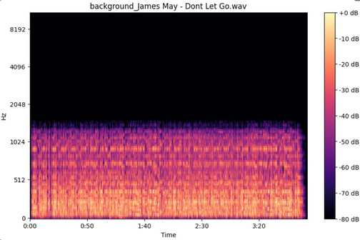
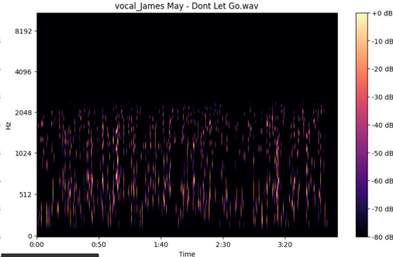
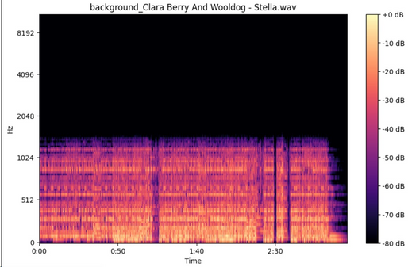
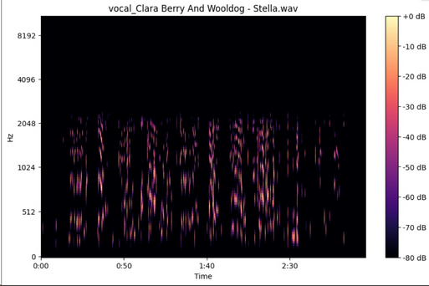
RESULTS !!
Song Name | Vocal SNR | Instrument SNR
James May - Don’t Let Go | 8.660355806350 | 5.15820145606
Titanium-Haunted Age Vocal | 93.28558921813 | 1.840024888515
Clara Berry -Stella | 17.57931947708 | 2.538655400276
Wall of Death -Femme | 15.92057704925 | 1.711479723453
Black Bloc- If you want Success | 8.141759634017 | 0.864511579275

Slide 8

CONCLUSION
Limitations
IVA with Gaussian Prior: It assumes statistical independence and is heavily dependent on the initialized mixing matrix.
NMF-based solutions have proven their efficacy to some degree but, we found it challenging to be able to tune the model for our specific tasks.
Robust PCA provided us with the best results. It was able to successfully seperate the vocal part from the instrumental part of the audio. It outperformed all the other attempted methods
Spectral Subtraction using Classification
It assumes that the background music is repetitive, so that it partitions.
Classification is time consuming due to large dataset.
Classification is limited due to mixed frequencies and dominant background at some places

Slide 9
THANK YOU
UDIT 2021213
VISHWESH VHAVLE 2020156
YASH YADAV 2021117
SOHAM CHITLANGIA 2021291

